Slide 1
cyclistic bike-share analysis
File created on: 5/28/2024 8:28:08 PM

Slide 2
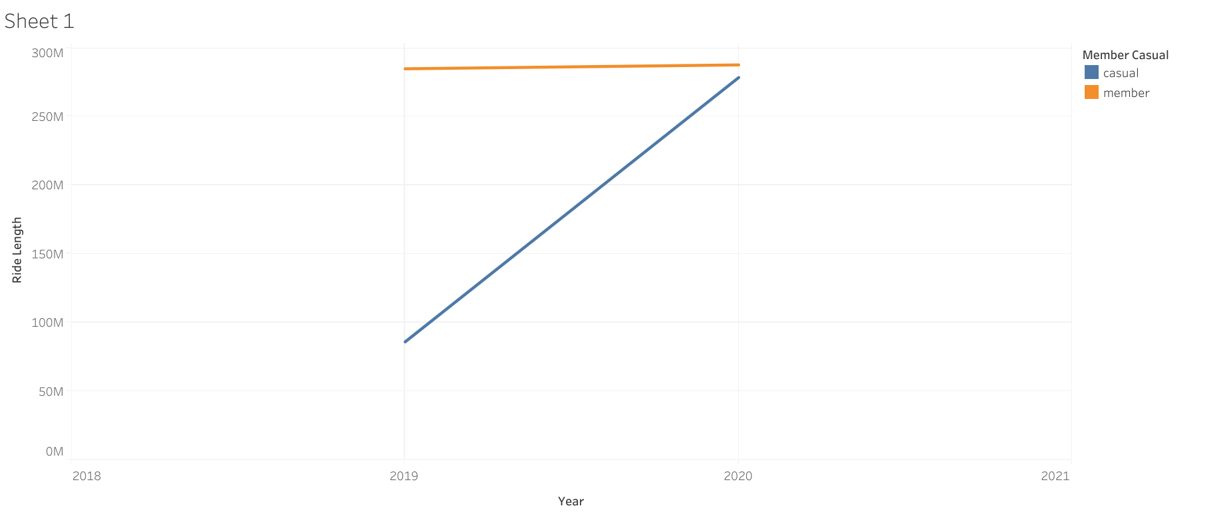

Slide 3
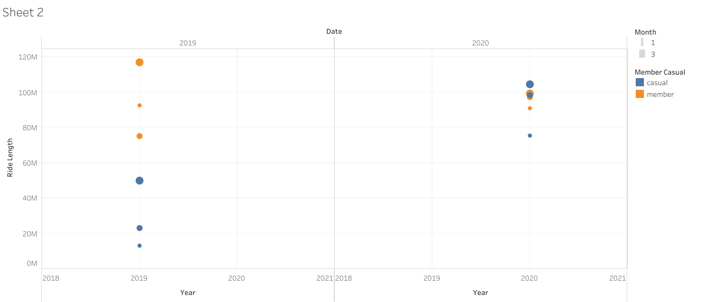

Slide 4
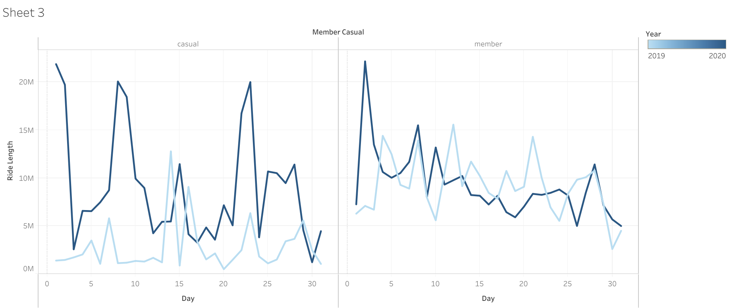

Slide 5
